Slide 1


PANIMALAR ENGINEERING COLLEGE,CHENNAI-600123 CSE DEPARTMENT DECENTRALISED REAL ESTATE-BLOCKCHAIN DR.S.HARIHARAN, M. E, Ph.D
BATCH-C12
SURYA R[211418104279]
YOGESH KUMAR K[211418104316]
SURYA S[211418104280]

Slide 2
ABSTRACT:
Developing a secure central system that not only accelerates the process of land registration but also makes it efficient will be effective. This project presents a blockchain-powered real estate management system that will provide a transparent, secure, and efficient system for real Signature estate management.
The proposed project allows a real estate agent to register a new person.
It also allows a real estate agent to register a property sale against a registered person.
Blockchain technology and smart contracts can sort out the classical issues that RE is facing, and they offer much more meaningful tools for a game-theoretic stable-priced market

Slide 3
EXISTING SYSTEM
The existing system doesn’t use blockchain and the existing system is mainly owned by agencies and brokers.
Also there are many scams and frauds occurring in the existing system due to the security issues

Slide 4
PROPOSED SYSTEM
The Proposed system is built in a secured by storing all the data in a blockchain
so there won’t be any frauds and scams can possibly happen.In the proposed system, fractional ownership feature is also added
so if many users can have a small fraction of ownership in a big land.
Also the proposed system will allocate NFT ( non – fungible token ) to all the buyers who are buying ,
so there avoid online and fake document scams.

Slide 5
SYSTEM ARCHITECTURE
This diagram is nothing but a simple description of all the entities that have been incorporated into the system.
The diagram represents the relations between each of them and involves a sequence of decision-making processes and steps.
You can simply call it a visual or
The whole process and its implementation.
All functional correspondences are explained in this diagram.

Slide 6
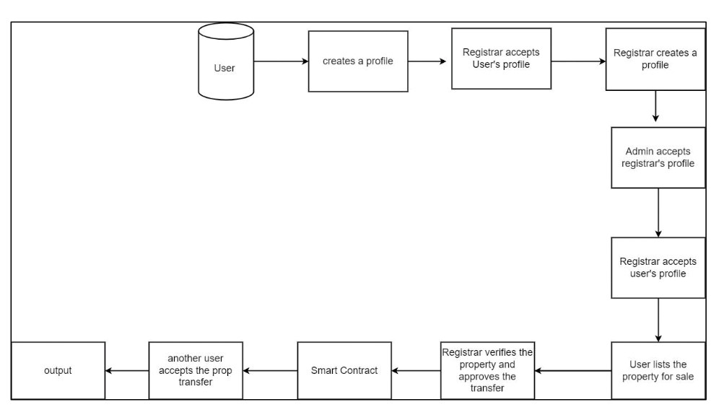
SYSTEM ARCHITECTURE

Slide 7
HARDWARE REQUIREMENTS
Processor : Pentium Dual Core 2.00GHZ
Hard disk : 120 GB
Mouse : Logitech.
RAM : 2GB (minimum)
Keyboard : 110 keys enhanced

Slide 8
SOFTWARE REQUIREMENTS
Operating system : Windows7 (with service pack1), 8, 8.1 and 10
IDE : Visual Studio Code
Backend : Node JS
Frontend : React

Slide 9
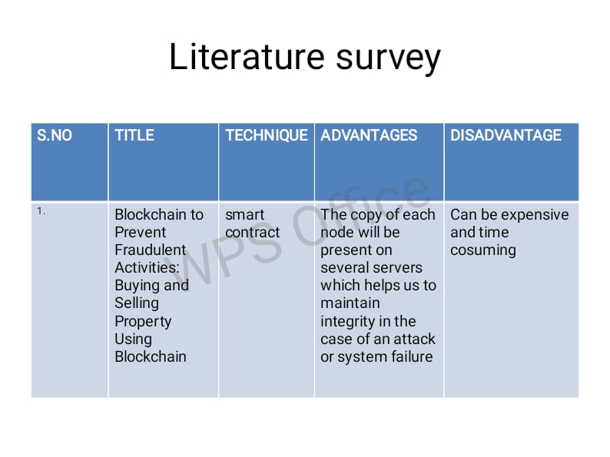
LITERATURE SURVEY

Slide 10
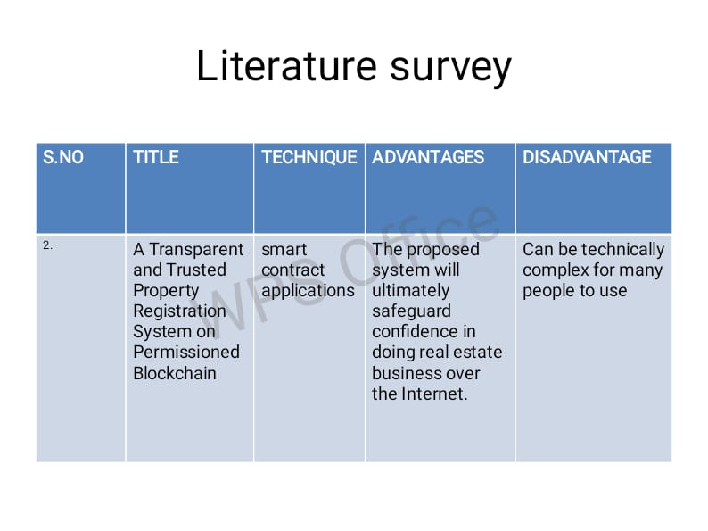
LITERATURE SURVEY

Slide 11
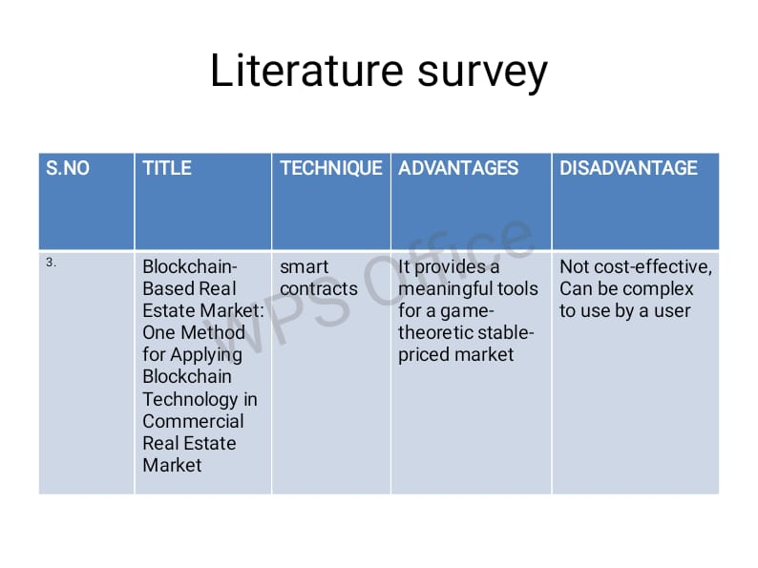
LITERATURE SURVEY

Slide 12
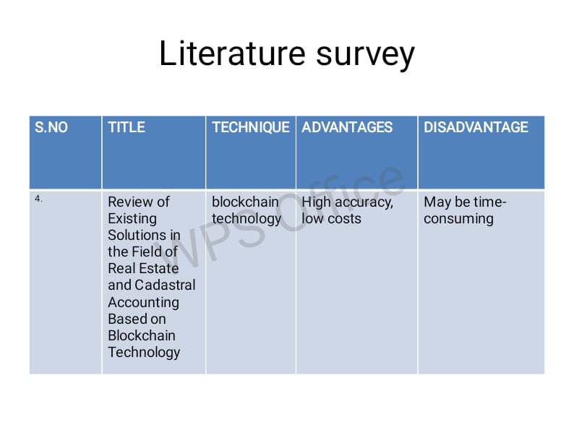
LITERATURE SURVEY

Slide 13
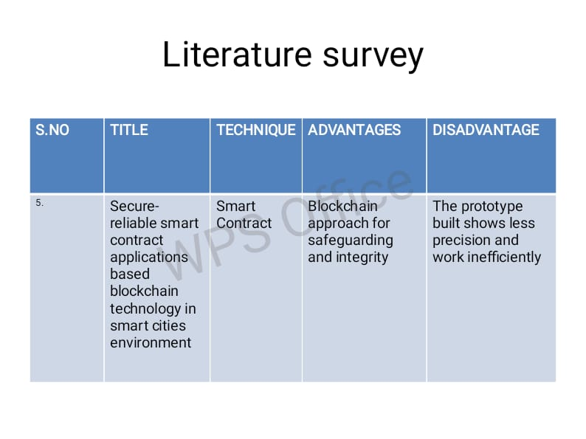
LITERATURE SURVEY

Slide 14

ThAnK yOu

